Slide 1
SoftHier Progress Update
Chi Zhang chizhang@iis.ee.ethz.ch

Slide 2
LLM deployment problem on SoftHier architecture
Input tokens
……
Next token
Embeding
Transformer
Layer1
Transformer
Layer2
Transformer
LayerL
Prediction
Head
Norm
MHA
Norm
MLP
+
+
Input
E
P
P
P
H*P
Input
x
W_{q}
=
Q
Q
Attention
softmax
S
x
V
O_{h1}
O_{h2}
…
O_{hh}
A
LLama3-70b
E | 4096
P | 128
H | 32
S | Sequence length(< 8192)
S
S
S
x
S
x
E
K^{T}
W_{a}
Input
x
W_{k}
=
K
Input
x
W_{v}
=
V
Attention Head

Slide 3
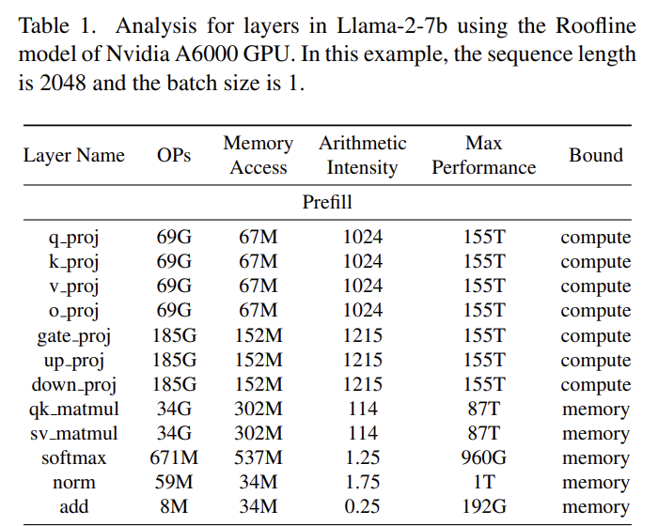


LLM deployment problem on SoftHier architecture
Input
E
P
P
P
H*P
Input
x
W_{q}
=
Q
Q
Attention
softmax
S
x
V
O_{h1}
O_{h2}
…
O_{hh}
A
S
S
S
x
S
x
E
K^{T}
W_{a}
LLama3-70b
E | 4096
P | 128
H | 32
S | Sequence length(< 8192)
Input
x
W_{k}
=
K
Input
x
W_{v}
=
V
Attention Head
QKV
Projection
Attention
(QK_Matmul)
SoftMax
SV_Matmul
Output
Projection
HBM
HBM
HBM
HBM
Attention
Attention
H*P
Q
K
V
Attention
Attention
Q
K
V
Attention
Attention
Q
K
V
Attention
Attention
Q
K
V
Attention
Attention
Q
K
V
Attention
S
Q
K
V
O_{h1}
O_{h2}
…
O_{hh}
S
S
S
S
P
H
S
H
S
H
Compute
Bound
Memory
Bound
Memory
Bound
Memory
Bound
Compute
Bound

Slide 4
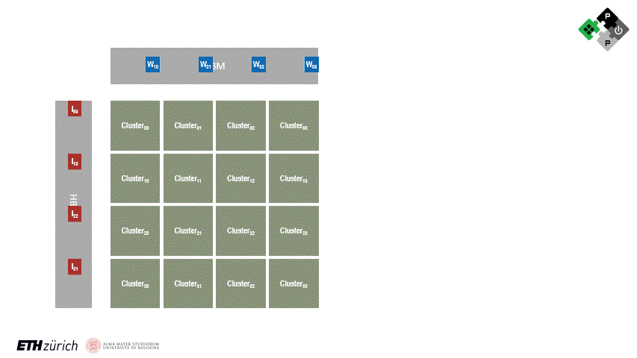

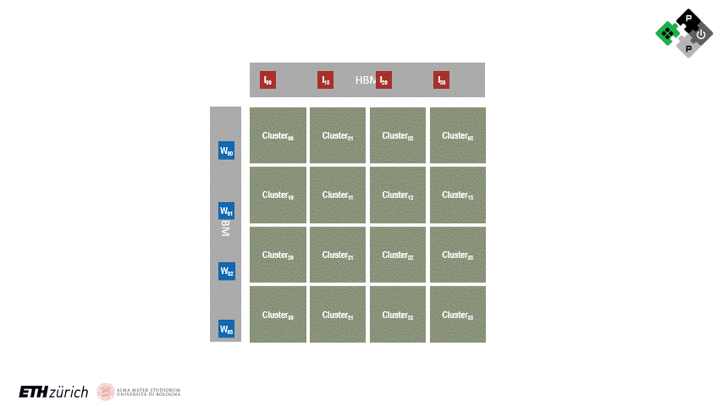
Deployment problem on SoftHier architecture
Big Exploration Space of Mapping LLM to SoftHier
Micro-kernels mapping
Tiling policy
Cluster mapping policy
Inter-cluster comm policy (Spatial Computing)
Micro kernel fusing schemes
Questions
Can DaCe deal with it?
SDFG representation
SDFG transformation/optimization
Micro Kernels
[data size, M, N, K …]
SoftHier Arch Description
[Mesh 8x8, 1MB TCDM per cluster, 16 HBM ch, ..]
Workload Tiling Policy?
Cluster Workload Mapping Policy?
Inter-Cluster Communication Policy?
Scheme 1
Scheme 3
Scheme N
Scheme 2
?
Code Generation
SoftHier GVSoC model
Best Solution
High Compute Uti
Low NoC traffic
Low HBM traffic

Slide 5
Deployment problem on SoftHier architecture
Current we can hand-write code for LLM mapping
Following simple policy
RedMule-Fit tiling
Each cluster focus on one output tile
Systolic-stream tiles on-chip (GEMM)
No kernel fusion considering
Target a given LLM workload
One layer of Llama3-70B
Inference-prompt phase (No KV cache here)
Sequence length of 256
Micro Kernels
[data size, M, N, K …]
SoftHier Arch Description
[Mesh 8x8, 1MB TCDM per cluster, 16 HBM ch, ..]
Workload Tiling Policy?
Cluster Workload Mapping Policy?
Inter-Cluster Communication Policy?
Scheme 1
Scheme 3
Scheme N
Scheme 2
?
Hand
Write
Code
SoftHier GVSoC model
Evaluation

Slide 6
Review of Original SoftHier Project Proposal
First Year Milestones(IIS side):
Baseline Simulator and HW Model (M6): Enhancement of Banshee open-source simulator to support tensor operators and KiloPE tensor units. Incorporation of multiple TPs and baseline performance models.
Update: Switched to GVSoC for improved model timing accuracy, especially for DMA, NoC, and HBM models.
Baseline SoftHier model completed in GVSoC. Open-sourced in GitHub repository.
Currently conducting architecture design space exploration.
PPA Assessment and Models with Baseline RTL (M12): A first set of synthesis trials will be run on DMAs and interconnects to estimate cost and performance of the first version of hardware and provide the key components for system-level PPA assessment
Next Steps:
Conduct backend work on the RTLs of FlooNoc, iDMA, and RedMule at different scales:
Focus on data width and CE arrays.
Determine area overhead and scale limits for a given tech node.

Slide 7
SoftHier Progress Update
Luca Colagrande colluca@iis.ee.ethz.ch

Slide 8
Snitch cluster
Several PRs merged in the last weeks:
Hardware
Multi-channel DMA integration: #144
Improve performance counters for bringup: #155
Software
New kernels: #185, #190
Runtime improvements: #147, #180, #186
Utilities, documentation and maintenance work
#172, #158, #115, #173, #177, #178, #71, #188, #189, #187

